Slide 1
Cryptography 1
Introduction to Offensive Security

Slide 2
What is Cryptography
Transmitting a message between 2 parties without having a listener be able to tell what's being said
Alice wants to talk to Bob
But Eve is eavesdropping!
How can Alice talk with Bob privately?

Slide 3
Classical Ciphers
Substitution ciphers
Bijective map from each character to another
Why bijective?
Monoalphabetic
Let a->z, b->y, c->x, …
hello
svool

Slide 4
Classical Ciphers
Caesar cipher
a.k.a. shift cipher
A simple family of substitution ciphers
Each character maps to the character some number of positions down the alphabet
If shift is 1: a->b, b->c, c->d, etc.
Hello!
Ifmmp!
ROT13

Slide 5
Classical Ciphers
Breaking a Caesar cipher
There are only 26 options…
Try them all!
But we can do better!
Frequency analysis

Slide 6
Frequency Analysis
Some characters are used more than others
For English, " " (space) and "e" are super common characters while "j", "q", "x", and "z" are almost never used
For a large enough ciphertext, the frequency distribution should roughly match the general English distribution
Then, we just have to match the letters together!

Slide 8
Frequency Analysis
This can also be extended to more than one character: n-gram analysis
Bigram analysis: matching the distribution of character pairs
https://en.wikipedia.org/wiki/Bigram#Bigram_frequency_in_the_English_language

Slide 9
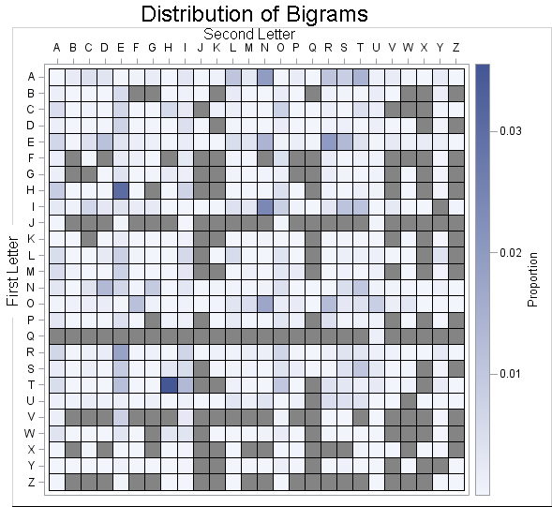
English bigram frequencies

Slide 10
Polyalphabetic Ciphers
One character no longer always encrypts to the same result!
The result somehow combines the message and a key
Vigenère cipher
Shift cipher where the offset is based on the current character in the key
Message is "ABC", key is "ABC"
A->A
B->C
C->E
Ciphertext is "ACE"

Slide 11
Vigenère square

Slide 12
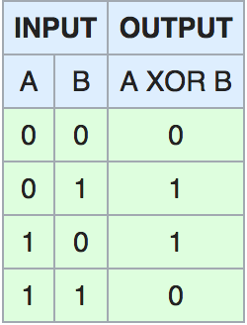
XOR
eXclusive OR
You probably remember this from one of many prior classes
Output is 1 if A or B is 1, but not if both are
⊕ is the symbol to represent the operation
Programming languages usually use ^
Has some nice properties:
A⊕B⊕A = B
It is its own inverse
(A⊕B)⊕C = A⊕(B⊕C)
Commutativity

Slide 13
XOR
A⊕B⊕A = B
It is its own inverse
If A is a key and can be transmitted securely, we can use this to encrypt!
Example
Alice wants to send m=13 to Bob
They've agreed on k=60
Alice computes 13 ^ 60 = 49, and sends it to Bob
Bob computes 49 ^ 60 = 13.
Eve meanwhile only sees 49!

Slide 14
XOR
Example 2
Alice wants to send m="Hello!" ([72, 101, 108, 108, 111, 33]) to Bob
They've agreed on k="foobar" ([102, 111, 111, 98, 97, 114])
Alice computes 72^102=46, 101^111=10, etc. and sends it to Bob
Bob computes 46^102=72, 10^111=101, etc.
Eve only sees [46, 10, 3, 14, 14, 83]
This is a One Time Pad (OTP) which is perfectly secure
As long as you don’t reuse the one time pad
As long as the one time pad is truly random
However, this relies on k being transmitted securely out of band
So why not transfer m this way?

Slide 15
XOR
So let's use a single byte!
Alice wants to send m="Hello!" ([72, 101, 108, 108, 111, 33]) to Bob
They've agreed on k=60
Alice computes 72^60=116, 101^60=89, etc. and sends it to Bob
Bob computes 116^60=72, 89^60=101, etc.
Eve only sees [116, 89, 80, 80, 83, 29]
But…

Slide 16
XOR
Eve tries to decrypt [116, 89, 80, 80, 83, 29] with all 1 byte values
One of them works! 60
Could also use frequency analysis
Sometimes NULL byte (or another constant) is common as well…
0^k = k, so a large chunk of the same values may be the key…
This breaks the cryptosystem entirely as the security hinges on a single byte which can be quickly brute forced

Slide 17
XOR
Ok, what about a repeating multi-byte key?
Alice and Bob agree on k="SecretKey" ([83, 101, 99, 114, 101, 116, 75, 101, 121])
For the sake of analysis, lets say m={contents of Alice in Wonderland}
How can we break this?

Slide 18
XOR
k="SecretKey" ([83, 101, 99, 114, 101, 116, 75, 101, 121])
If len(k) is known, create a new ciphertext with every len(k)'th character
i.e. take char 0, 9, 18, 27, etc. in one group, 1, 10, 19, 28, etc. in another, …
Then we can just perform our single-byte attack on each group

Slide 19
Symmetric Crypto
Basic XOR is symmetric – both Alice and Bob use the same key k
Other common symmetric crypto schemes:
RC4
DES
3DES
AES

Slide 20
AES
Block based symmetric encryption
Input is chunked into blocks of 16, 24, or 32 bytes (128, 192, 256 bits)
Multiple modes
ECB
Flaw: same input block results in same output block
CBC
Flaw: malleable. XOR on the ciphertext XORs the plaintext when decrypted
CTR
GCM
… many more

Slide 21
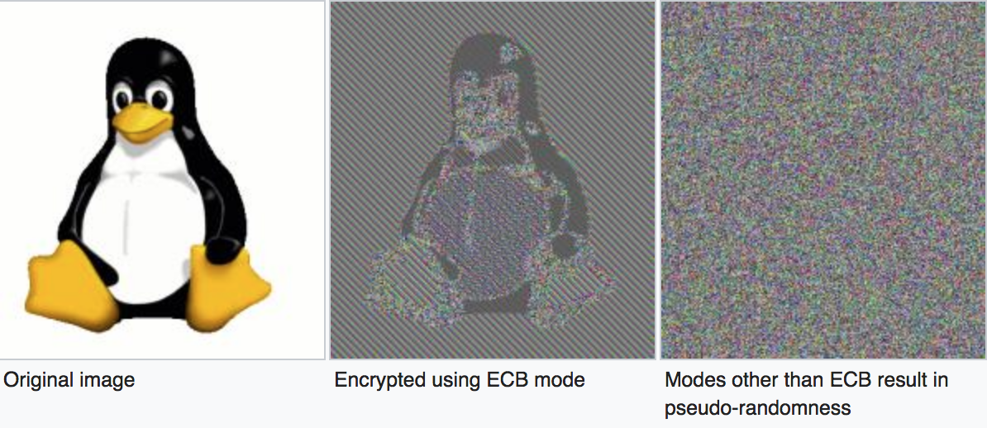
ECB Penguin

Slide 22
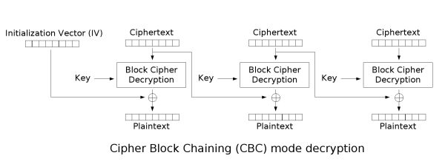
CBC Decryption Overview

Slide 23
CBC Malleability Demo

Slide 24
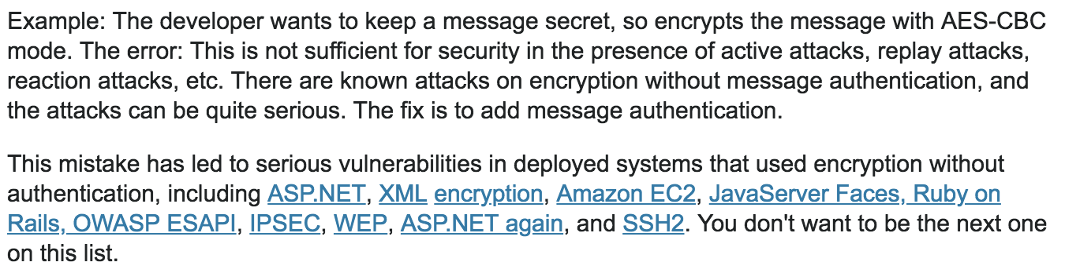
Real-World CBC Malleability Attacks
https://security.stackexchange.com/questions/2202/lessons-learned-and-misconceptions-regarding-encryption-and-cryptology/2206#2206

Slide 25
Solution to Malleability?
Use authenticated encryption!
Many out-of-the-box cipher modes support authentication natively
GCM, EAX, CCM, OCB, …
Do-it-yourself (less recommended):
We can use a message authentication code (MAC) to compute a hash of the message, and then use it to verify that the message was decrypted correctly
Encrypt-then-MAC:
Encrypt your data => C. Then compute MAC(C), and send C, MAC(C)
Encrypt-then-MAC works fine, but requires some care in implementing

Slide 26
Why not MAC-then-encrypt?
We could also imagine instead taking a MAC of the plaintext, and then checking it after decryption
Theoretical reason: Bellare and Namprempre, 2000
“Cryptographic Doom Principle”: if you have to perform any cryptographic operation before validating the MAC on a message, it will somehow likely lead to doom (Moxie Marlinspike, 2011)
https://moxie.org/blog/the-cryptographic-doom-principle/
Examples from the article:
Vaudenay Attack
Attack on SSH

Slide 27
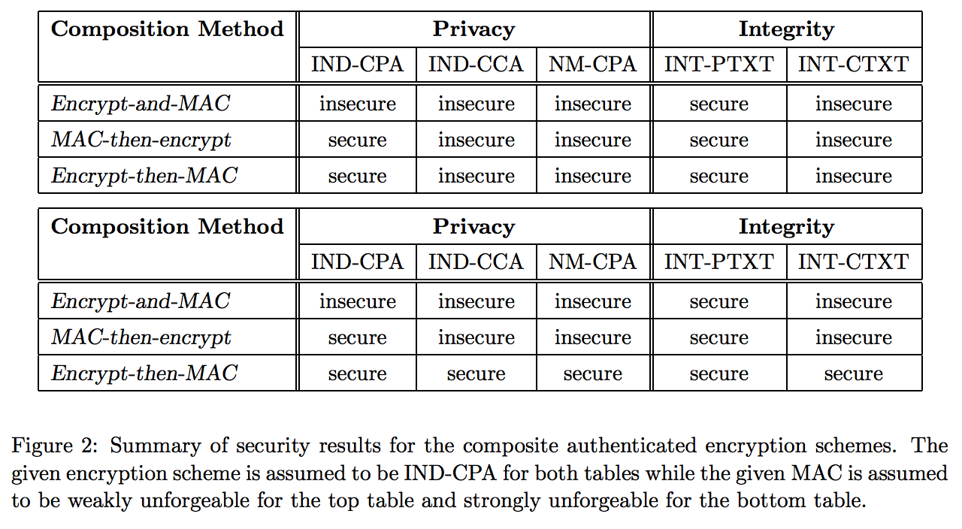
Bellare and Namprempre

Slide 28
Asymmetric Crypto
a.k.a. public key cryptography
Involves 2 distinct keys: a "public" key and a "private" key
Should be obvious which one you need to keep secret…
When you encrypt with one, it becomes readable only by the other
Works both ways
Encrypting with public key makes it decipherable only to those with the private key
"Encrypting" with private key can be used to sign messages
Commonly used to bootstrap symmetric crypto algorithms as they are faster

Slide 29
RSA
The most well known asymmetric cryptosystem
Let's walk through a sample encrypt/decrypt cycle

Slide 30
RSA Example (“textbook” RSA)
Alice generates a public/private key pair
Generates 2 (large) primes: p and q
Computes n=pq. This is the public modulus
Computes the totient of n: phi = (p-1)(q-1)
Pick a number e coprime to phi (usually 3, 5, 17, 257, 65537)
Compute d as the multiplicative inverse of e mod phi
(n,e) is the public key
(n,d) is the private key

Slide 31
RSA Example (“textbook” RSA)
Bob now wants to talk with Alice
Alice sends Bob the public key
Bob encrypts his message m by raising it to the public exponent (e) mod n
c = m^{e} (mod n)
Bob then sends the ciphertext c to Alice
Alice decrypts it by raising c to the private exponent (d)
m = c^{d} (mod n)
This turns into:
(m^{e})^{d} (mod n) => m^{ed} (mod n) => m¹ = m

Slide 32
Simple RSA Attacks
There are many, many ways to mess up implementing RSA
A great overview of attacks:
Dan Boneh: “Twenty years of attacks on the RSA Cryptosystem”
For RSA-based CTF challenges, maybe 90% of them will be based on an attack from this paper
We’ll only cover a few of the simpler ones in class

Slide 33
Factoring
Factoring the product of two large prime numbers is generally considered to be very hard
Theory note: although it is not known to be NP-Hard Probably lies in some complexity class between P and NP, but we don’t know for sure.
Future note: quantum computing, if realized, will change this. Shor’s algorithm is a polynomial time algorithm for factoring – as long as you’ve got a quantum computer!
If n is sufficiently small, we can just factor it!
Current best algorithm: General Number Field Sieve (GNFS)

Slide 34
Small Modulus Attack
Recall that to encrypt we do
m^{e} (mod N)
Q: does the attacker know e?

Slide 35
Small Modulus Attack
Recall that to encrypt we do
m^{e} (mod N)
Q: does the attacker know e? YES
(N,e) is the public key – everyone knows it
What happens if m^{e} < N?

Slide 36
Small Modulus Attack
Recall that to encrypt we do
m^{e} (mod N)
Q: does the attacker know e? YES
(N,e) is the public key – everyone knows it
What happens if m^{e} < N?
We can just take the e-th root to recover m!

